Slide 1








Stack Overflow Developer Survey 2019
AAKASH P
15 APRIL 2024

Slide 2



OUTLINE
Executive Summary
Introduction
Methodology
Results
Visualization – Charts
Dashboard
Discussion
Findings & Implications
Conclusion
Appendix

Slide 3

EXECUTIVE SUMMARY
Current Technology Usage Trend
Top 10 Languages Worked With
Top 10 Databases Worked With
Mostly Used Software Platforms
Top 10 Web Framework Worked With
Future Technology Trend
Top 10 Language Desired Next Year
Top 10 Databases Desired Next Year
Platform Desire Next Year by Respondent
Top 10 Web Framework Desired Next Year
Demographics Survey
Respondent classified by gender
Respondent Count for Countries
Respondent Count by Age
Respondent Count by Gender, classified by Formal Education Level

Slide 4

INTRODUCTION
Study on tech software and web development Industry around the world.
Purpose of study
To identify leading programing languages, databases and web frameworks.
Identify future scope of programing languages, databases and web frameworks.
Study on Respondent by using parameters like education , age and gender.

Slide 5

METHODOLOGY
Data gathering
Source: Stack overflow
Data wrangling
Exploratory data analysis
Visualization using python
Distribution of data
Correlation of fields with each other
Dashboard using IBM COGNOS
Current Technology Usage
Future Technology Trend
Demographics

Slide 6
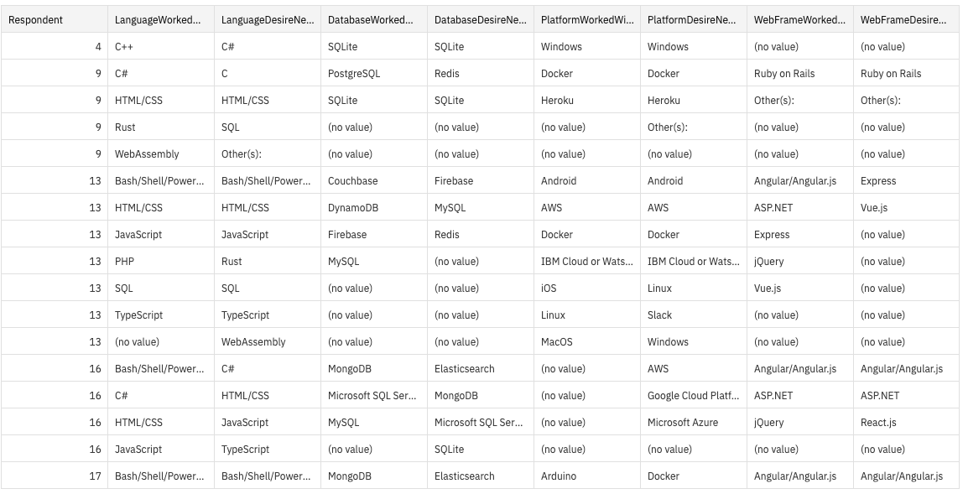
RESULTS

Slide 7
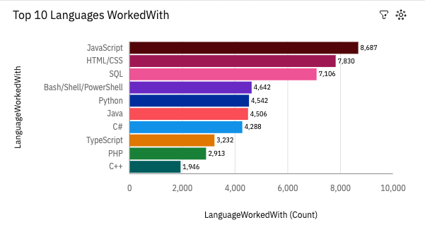
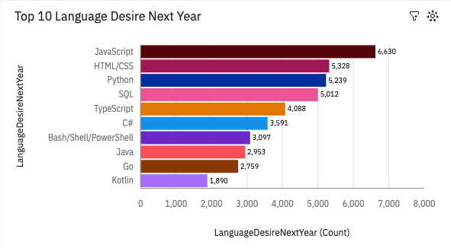
PROGRAMMING LANGUAGE TRENDS

Slide 8
PROGRAMMING LANGUAGE TRENDS - FINDINGS & IMPLICATIONS
Findings
JavaScript and HTML/CSS are booming in this year as well as next year.
Python overtakes SQL on next year and Typescript also getting highly popular.
Power shell seem losing its demand.
Implications
Python and SQL get booming It can contribute well for AI and ML (Data Science) Field
Web development and web developers are high in demand.

Slide 9
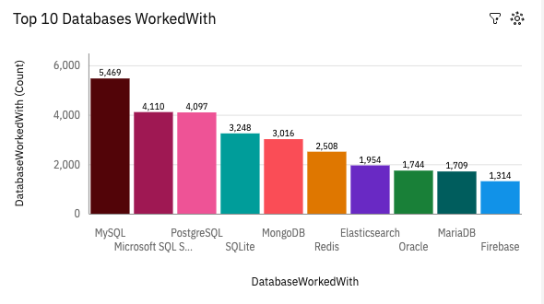
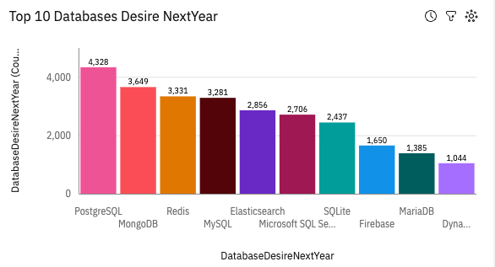
DATABASE TRENDS

Slide 10
DATABASE TRENDS - FINDINGS & IMPLICATIONS
Findings
MySQL holds First position, but in next year Postgres SQL take over MySQL
MongoDB’s Trend is increasing in coming year
NoSQL are getting in trend in upcoming year
Implications
Relational databases are inevitable for software development
NoSQL getting high in demand due to the increased volume of data in modern world
Open-Source databases are in demand.

Slide 11

DASHBOARD
<The GitHub link of the Cognos dashboard goes here.>

Slide 12
DASHBOARD TAB 1
Screenshot of dashboard tab 1 goes here

Slide 13
DASHBOARD TAB 2
Screenshot of dashboard tab 2 goes here

Slide 14
DASHBOARD TAB 3
Screenshot of dashboard tab 3 goes here

Slide 15
DISCUSSION

Slide 16
OVERALL FINDINGS & IMPLICATIONS
Findings
Finding 1
Finding 2
Finding 3
Implications
Implication 1
Implication 2
Implication 3

Slide 17

CONCLUSION
Point 1
Point 2
Point 3
Point 4

Slide 18

APPENDIX
Include any relevant additional charts, or tables that you may have created during the analysis phase.

Slide 19
JOB POSTINGS
In Module 1 you have collected the job posting data using Job API in a file named “job-postings.xlsx”. Present that data using a bar chart here. Order the bar chart in the descending order of the number of job postings.

Slide 20
POPULAR LANGUAGES
In Module 1 you have collected the job postings data using web scraping in a file named “popular-languages.csv”. Present that data using a bar chart here. Order the bar chart in the descending order of salary.

